Slide 1
Text Editor
Advanced Java Programming(22517)
Micro-Project

Slide 2
Group Member’s
Kaushik Shigavan - 19203A0003
Harshad Raurale - 19203A0029

Slide 3
Brief Introduction:
JAVA was developed by James Gosling at Sun Microsystems Inc in the year 1991, later acquired by Oracle Corporation.
It is a simple programming language. Java makes writing, compiling, and debugging programming easy. It helps to create reusable code and modular programs.
It is an advanced technology or advance version of Java specially designed to develop web-based, network-centric or enterprise applications, it includes the concepts like Servlet, JSP, JDBC, RMI, Socket programming, etc.
A text editor is a tool that allows a user to create and revise documents in a computer. Though this task can be carried out in other modes.
The word text editor commonly refers to the tool that does this interactively.
For this project, we are using the jdk 1.8 and sublime editor.

Slide 4
Aim of the Micro Project:
1. User should able to write text in this text editor.
2. User should able to new blank editor.
3. User should able to save the typing text file.
4. User should also able to open the file.
5. User should able to change the font color, font size and font styles.

Slide 5
Actual Resources Used:
Sr. No. | Name of Resource/Material | Specifications | Qty | Remarks
1 | Notes and useful websites | For collecting information | -
2 | JKD 1.8 and Sublime Editor | To write the Code | 1
3 | Microsoft Word | To make report | 1

Slide 6
Course Outcomes:
Develop programs using GUI Framework (AWT and Swing).
Handle events of AWT and Swings components.
Develop programs to handle events in Java Programming.

Slide 7
Actual Procedure Followed:
First, we created the class such as “My_Notepad” and extend to frame and implements the ActionListener.
Then we created all the components such as “TextArea”, “MenuItem”, “Menu”, “MenuBar”, “MenuShortcut” in private.
Then we created the constructor of class My_Notepad and assign all the components.
After that we add all the component in the frame sequence wise.
Then we assigned “addActionListener” to all components by using “this” keyword.
By using “setTitle” and “setSize” we assign the frame title and frame size.
After we used the addWindowListener to close the frame.
Then we created a “actionPerformed(ActionEvent ae)” function to assign all the action and event to all the components.
Then we created the class named “Notepad” and in main function we call the constructor of class “My_Notepad”.

Slide 8
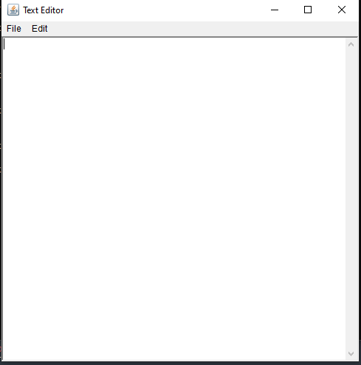
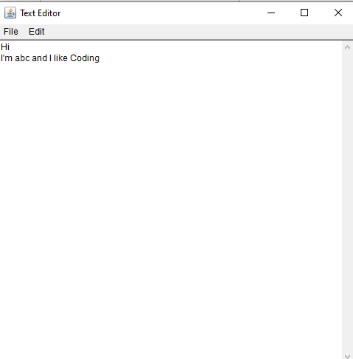
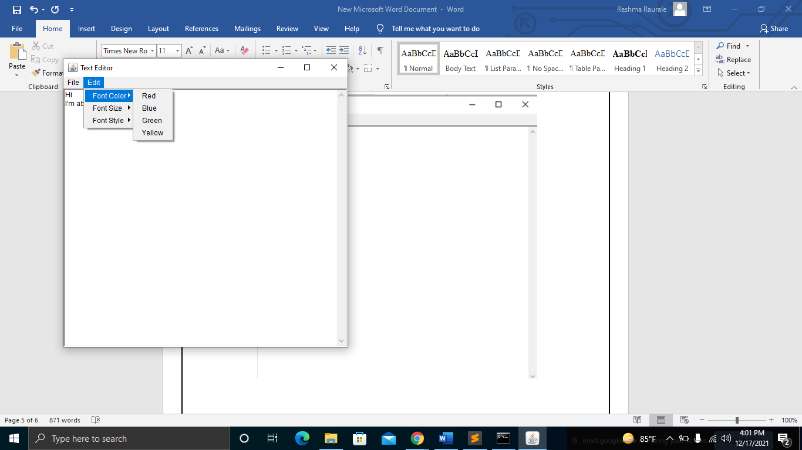
Outputs of the Micro Project:

Slide 9
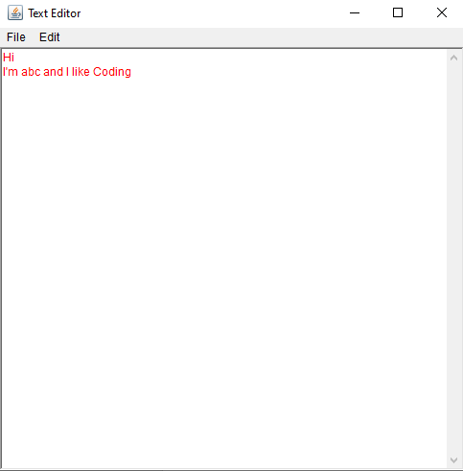
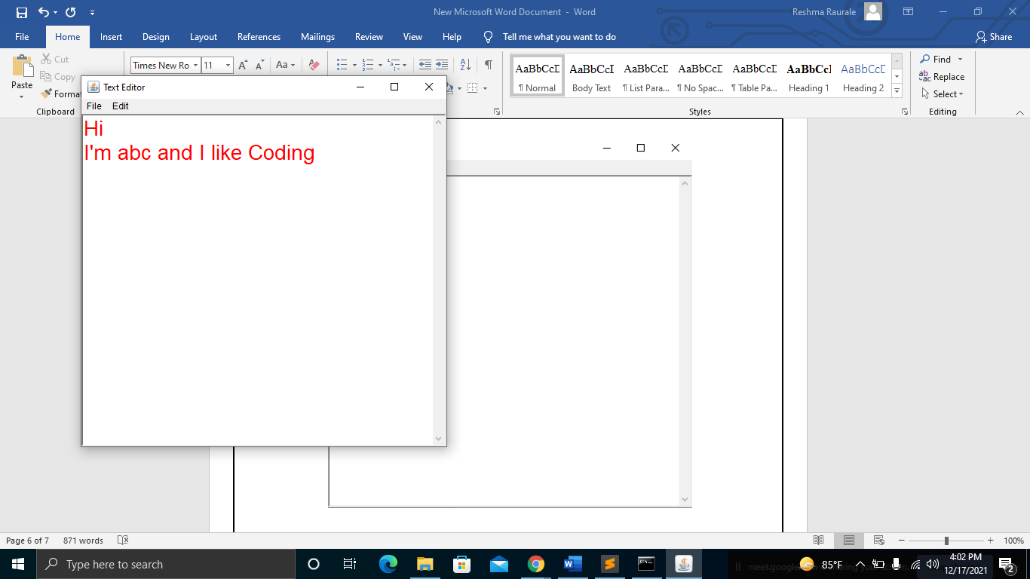
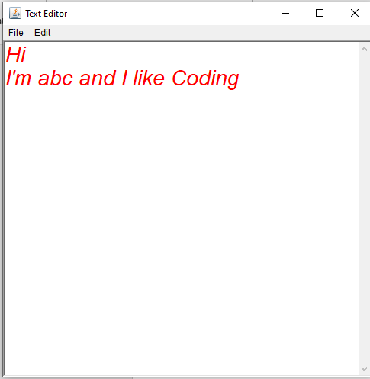
Outputs of the Micro Project:

Slide 10
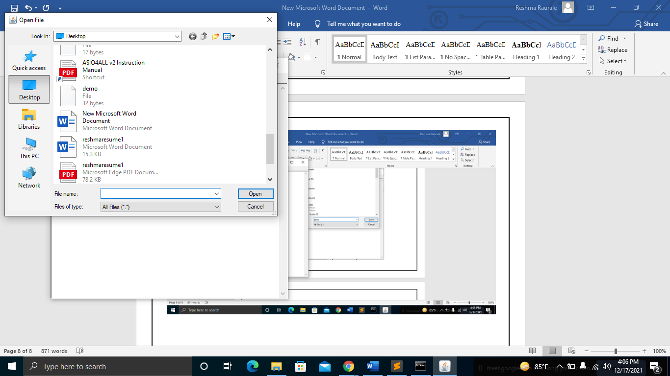
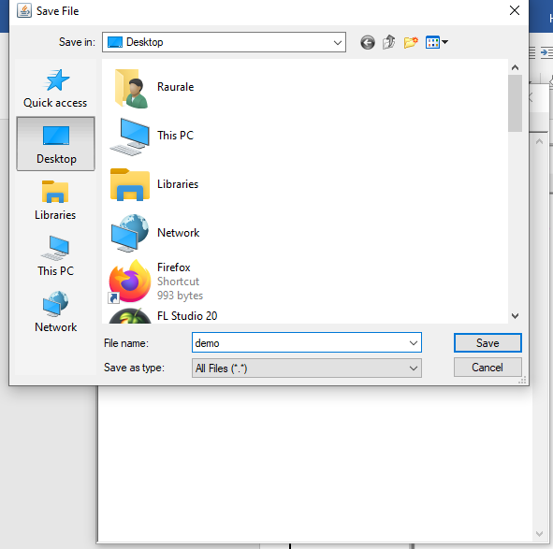
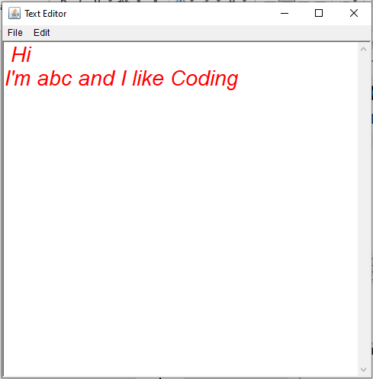
Outputs of the Micro Project:

Slide 11
Thank You

